Slide 1


NLP: Recurrent Neural Network
Video 9: Understanding GRUs

Slide 2

Advanced RNN
RNN
GRU
LSTM

Slide 3
Advanced RNN
RNN
GRU
LSTM

Slide 4
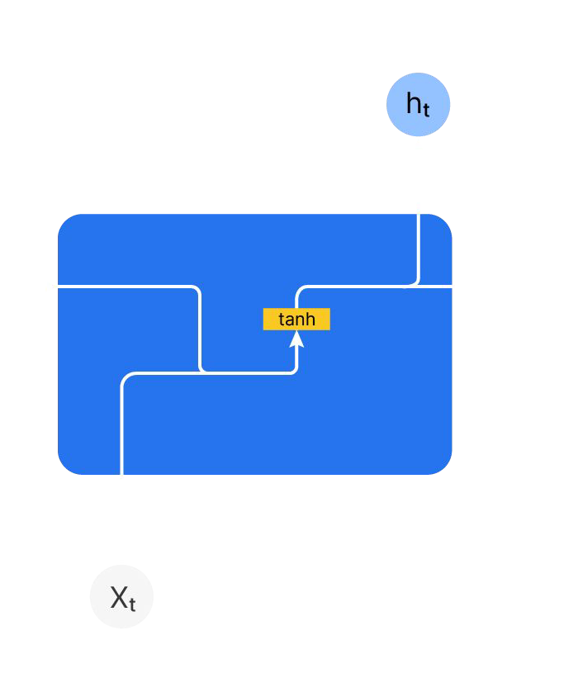

RNN
RNN
y_{t}
^{h}t-1
h_{t}

Slide 5
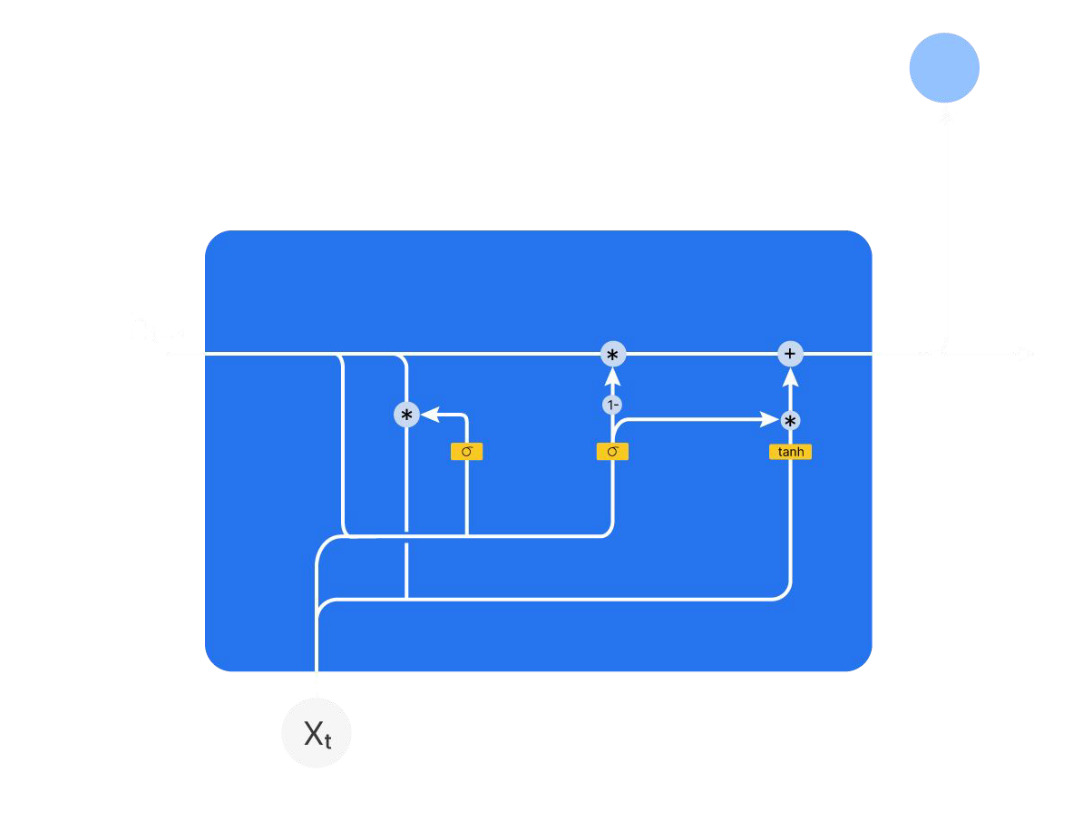
RNN V/s GRU
RNN
GRU
y_{t}
y_{t}
^{h}t-1
h_{t}
^{h}t-1
h_{t}
X_{t}

Slide 6
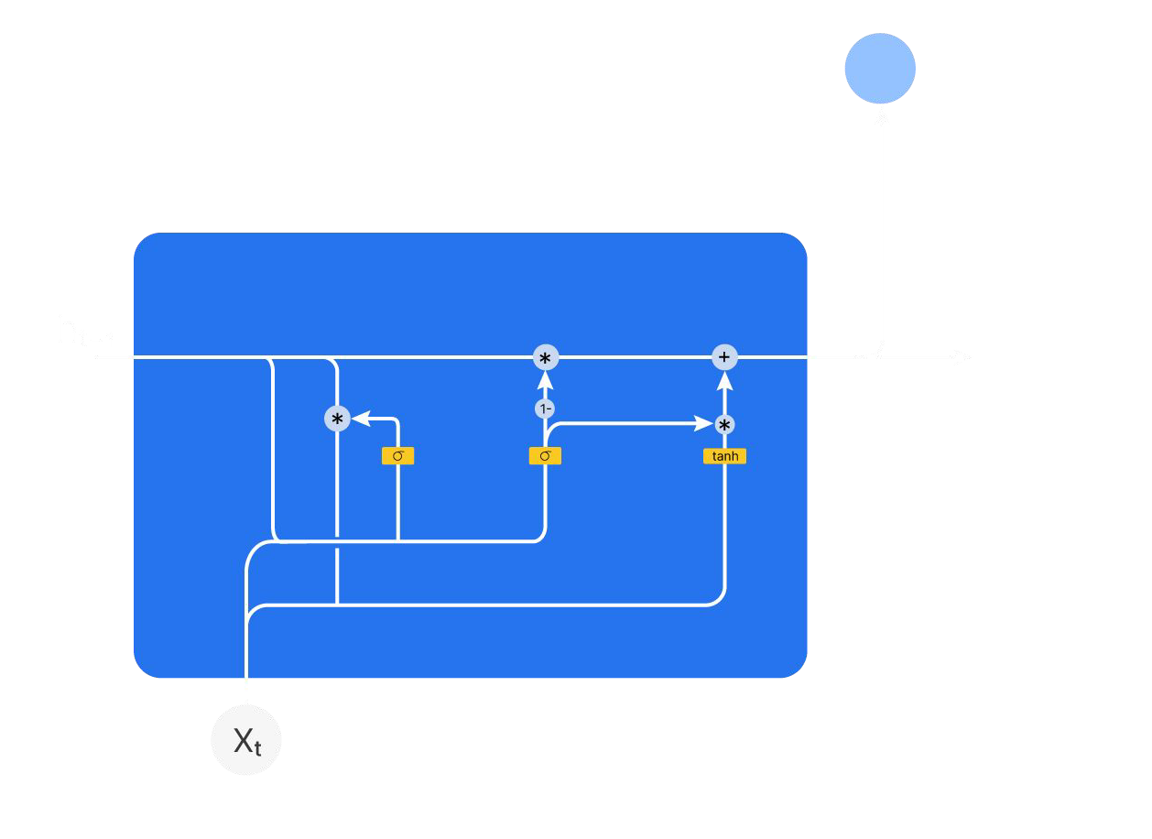
Architecture of GRU
hy_{tt}
Update gate
Update gate : Select component from previous and current hidden state
h_{t}
h_{t}= U_{g}*(ĥ_{t}) + (1-U_{g})*h_{t-1}
Candidate hidden state
Update gate

Slide 7
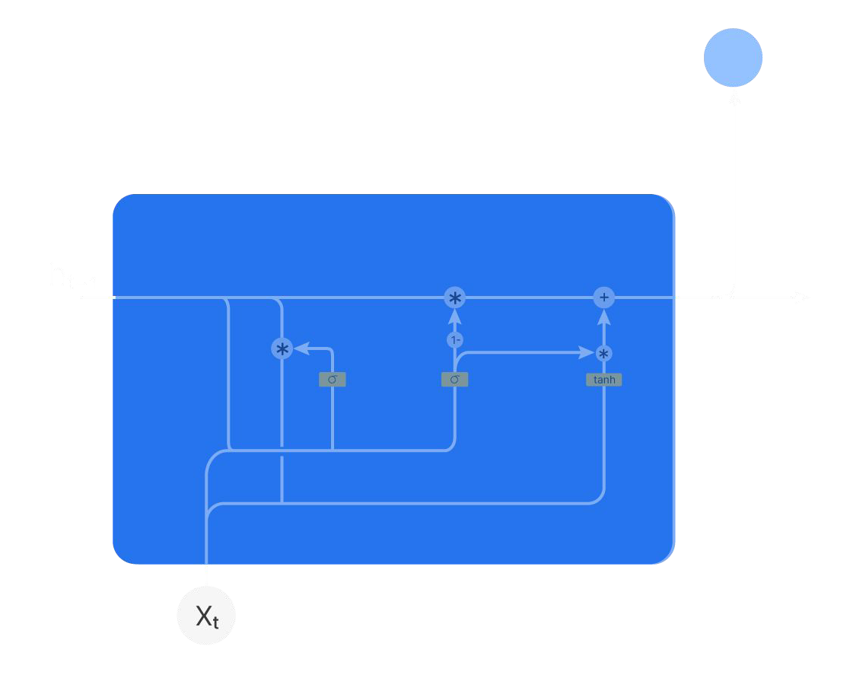

GRU : Update gate
yh_{tt}
h_{t}
*
+
h_{t}= U_{g}*(ĥ_{t}) + (1-U_{g})*h_{t-1}
1-
*
ĥ
t
σ
U_{g}
U_{g} 1 Prioritize new information
U_{g} 0 Retain old information

Slide 8

GRU : Calculation of Update gate
yh_{tt}
h_{t}
U_{g} = σ( X_{t} . W_{xu} + h_{t-1} . W_{hu} + b_{u}
)
σ
U_{g}

Slide 9
GRU : Calculation of Update gate
yh_{tt}
W_{u}
h_{t}
U_{g} = σ( X_{t} . W_{xu} + h_{t-1} . W_{hu} + b_{u}
)
σ
U_{g}
U_{g} = σ( W_{u} [X_{t} , h_{t-1}]+ b_{u} )

Slide 10

GRU : Update gate
yh_{tt}
U_{g} = σ( W_{u} [X_{t} , h_{t-1}]+ b_{u} )
h_{t}
h_{t}= U_{g}*(ĥ_{t}) + (1-U_{g})*h_{t-1}
*
+
1-
* _{ĥ}
σ
U_{g}
t
Candidate hidden state

Slide 11


GRU : Calculation of Candidate hidden state
yh_{tt}
Reset gate vector
Candidate hidden state : Represent the potential new content to be part of
current hidden state.
h_{t}
R_{g}
*
ĥ_{t}
ĥ_{t} = tanh (W_{h} [ x_{t} , R_{g}* h_{t-1} ] + b_{h})
tanh
Reset gate

Slide 12
Architecture of GRU
hy_{tt}
Reset gate
Update gate
h_{t}

Slide 13


GRU : Calculation of Candidate hidden state
y_{t}
h_{t}
R_{g} = σ( W_{R} [X_{t} , h_{t-1}]+ b_{R} )
σ
R_{g}

Slide 14
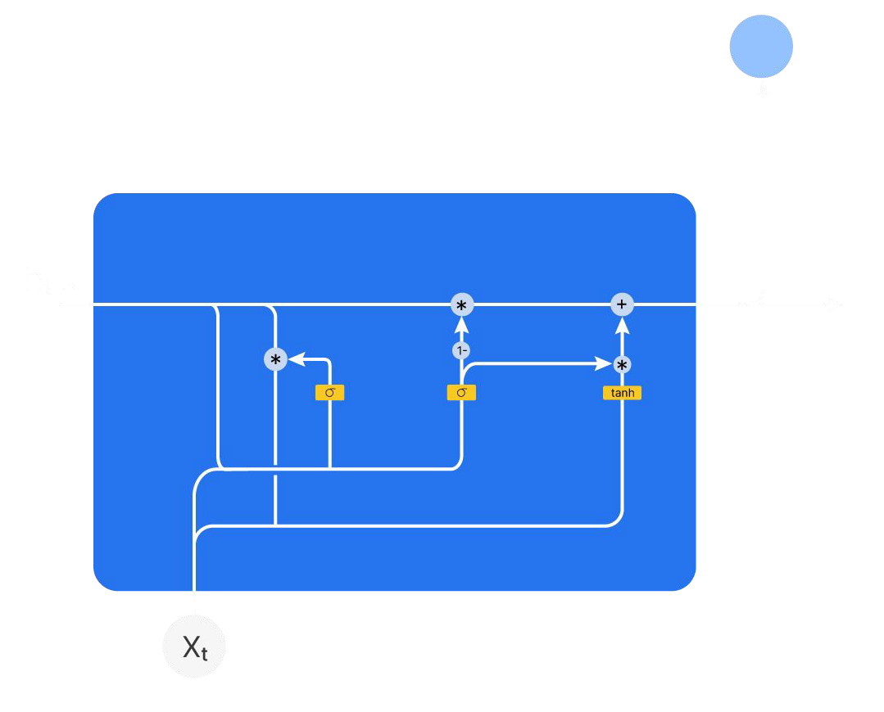
Architecture of GRU
y_{t}
U_{g} = σ( W_{u} [X_{t} , h_{t-1}]+ b_{u} )
h_{t}= U_{g}*(ĥ_{t}) + (1-U_{g})*h_{t-1}
ĥ_{t} = tanh (W_{h} [ x_{t} , R_{g}* h_{t-1} ] + b_{h})
R_{g} = σ( W_{R} [X_{t} , h_{t-1}]+ b_{R} )

Slide 15


Architecture of GRU
Example
-0.16
Quality
-0.05
Gender
h_{t}
^{h}t-1
1.08
Emotion
6.56
Power
Enthusiasm
2.45

Slide 16
Up Next: GRU in Jupyter

